Slide 1
AMICT’2013
Petrozavodsk, October 15, 2013
Measuring Internet Traffic
Professor Arto Karila
Aalto-HIIT
E-mail: arto.karila@hiit.fi

Slide 2
The rise of digital services
Corporations are distributing their operations globally
Increasing income increases the demand for services
Officially services are 20% but in reality 50% of world trade (statistics based on value added vs. gross value)
For example in Finland, already about 90% of work is services
A growing share of the services can be digitalized and consumed independently of place and time
An open global information network is a necessary channel for the distribution of digital services
Source: “New value from services” (in Finnish), M. Pajarinen, P. Rouvinen, P. Ylä-Anttila, December 2012, http://pub.etla.fi/ETLA-B256.pdf

Slide 3
Digitalization increases trade of services
World
Finland
ICT-utilizing services
ICT-utilizing services
Traditional services
Export of goods
Traditional services
Export of goods
Source: ETLA, 2012. Index: 2000 – 100. ICT-utilizing: Finance, Insurance, Communications, IT, Business Services, Royalties, License Fees

Slide 4
Information Centric Networking
There is a growing consensus among researchers that a fundamental reform of the Internet will be needed soon
A big challenge to any new internetworking architecture is its scalability to global video and hundreds of billions of hosts
Aalto / HIIT has for the past six years conducted research on Information Centric Networking (ICN) with first-rate European partners
ICN focuses on information (not on hosts)
In ICN, caching and multicast are used extensively (see next slide on the cost of storage vs. transit)

Slide 5
Storage vs. Transit
2009
$100/MB
$10/MB
$1/MB
Raw disk space
$100/GB
$10/GB
Tier-1 Internet Transit*
$1/GB
$0.1/GB
1985
1990
1995
2000
2005
2010
Source: Dr. Pekka Nikander

Slide 6
Validating Future Internet Architectures
Future Internet Research requires validations of designs in as real-life-like environments as possible
Analysis and test-bedding are necessary but not sufficient
Large-scale validation requires simulation
To be able to validate the scalability and performance of our design, we need realistic models of Internet traffic
Unfortunately, Internet Service Providers (ISPs) consider their interconnections and traffic patterns trade secrets
Also legislation (e.g. that based on EU directive 2002/58 on privacy and electronic communications) makes it difficult to obtain reliable information
We believe that the legal impediments can be overcome

Slide 7
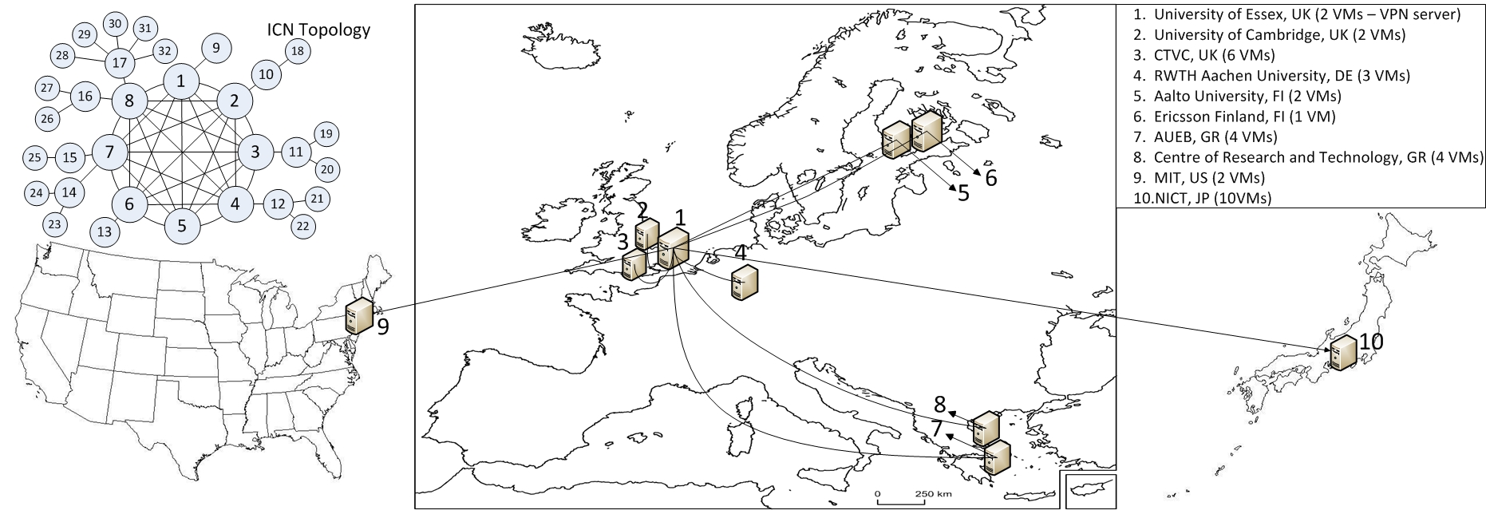
PURSUIT Test Bed
International test bed, 10 sites (8 PURSUIT partners, MIT, NICT), 30+ permanent machines running, upcoming IECIE paper on experiments
Additionally a node at Tsinghua University, Beijing
Dedicated 1GBit/s and 10GBit/s test bed for high-speed measurements
Local Android deployments
Emulation environment with computing clusters

Slide 8
Current Plans
The Chinese Future Network Innovation Center (FNIC) of Nanjing and HugeData corporaton have developed a system for measuring Internet traffic and collecting data for mining
We are planning to implement a probe to the measuring platform for collecting information on traffic patterns
We intend to place probes in central nodes in China and Finland and collect information about real Internet traffic
We also have plans to expand the system to other EU countries, probably starting from Germany
We already have cooperation with MIT (US) and RWTH Aachen (Germany)
The data collected can be used in many ways, including Future Internet research projects of EU Horizon 2020

